Slide 1

Shaun Cobb, Jordan Pan, Shane Polwort, Daari Terrell, ChristyAnna Zimmerman

Slide 2
Agenda
Project Overview
Architectural Design & Technologies
Physical Design & Implementation
Validation and Verification
Product Evolution
Demo

Slide 3
Project Overview

Slide 4
Project Overview
Team Background
Education Application
3 Distinct Modes of Learning

Slide 5
Architectural Design & Technologies

Slide 6
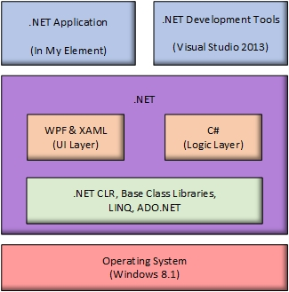
Development Technologies
Windows 8 OS
MS Visual Studio 2013 IDE
WPF project template
XAML-based interface
C# code behind
SQLite embedded dbase

Slide 7
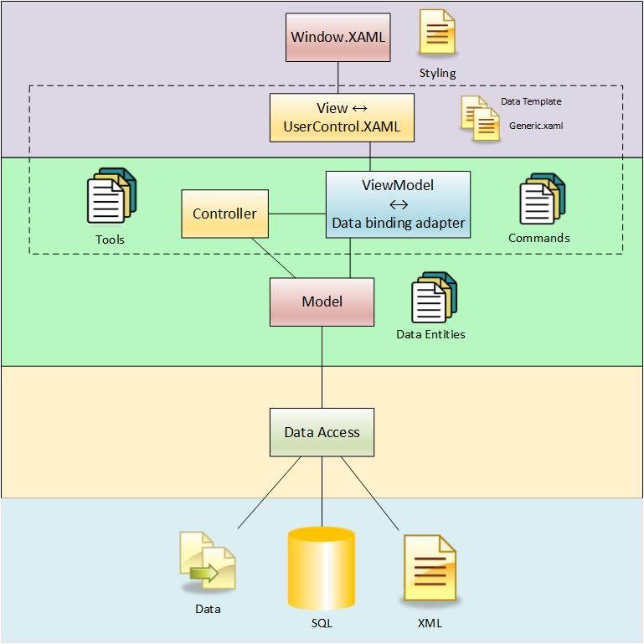
Logical Architecture MVVM (Model-View-ViewModel) Design Pattern
Presentation (UI) Layer
Business Layer
Data Access Layer

Slide 8
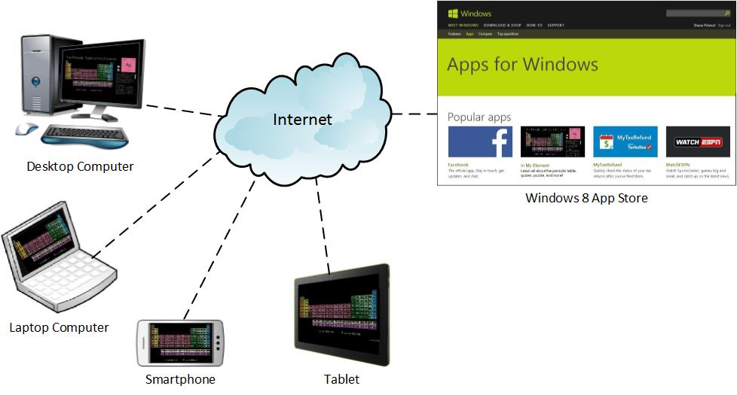
Physical Architecture
App hosted on Windows Store
Downloaded by User
Runs on Windows 8 devices
Desktops
Laptops
Tablets
Smartphones
No network connectivity required

Slide 9
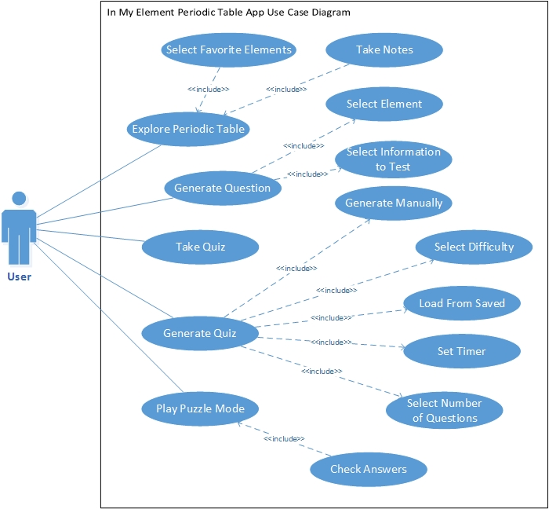
From Specification to Design
Many Use Cases Developed
Starting point for design effort
Guidance during condensed development cycle
Roadmap for validation/testing

Slide 10
Physical Design & Implementation

Slide 11
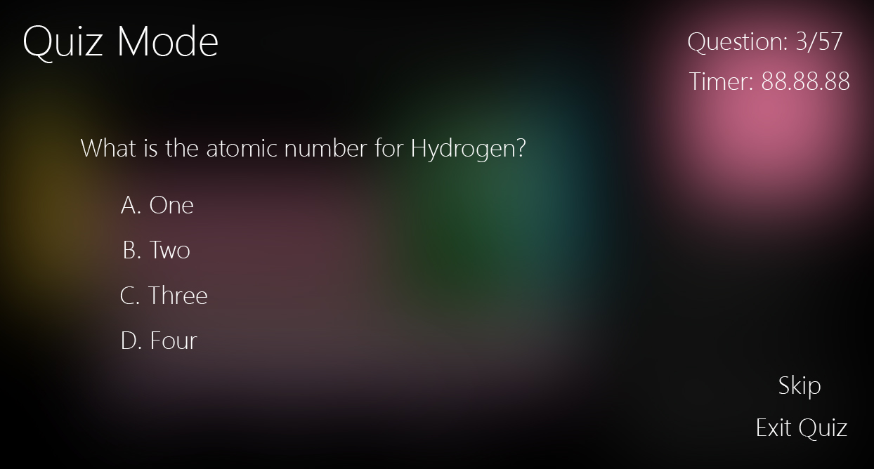
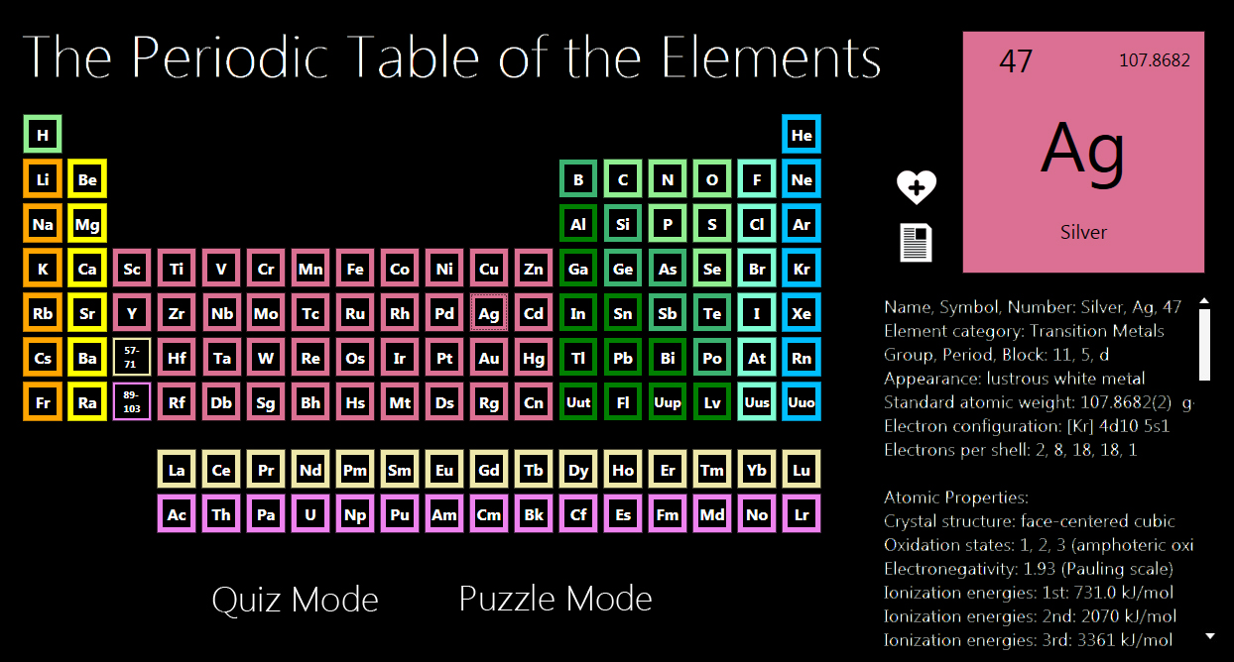
UI Mock Ups
Windows 8 Metro Style
Flat UI Design
No Shadows
No Textures
No Gradients

Slide 12
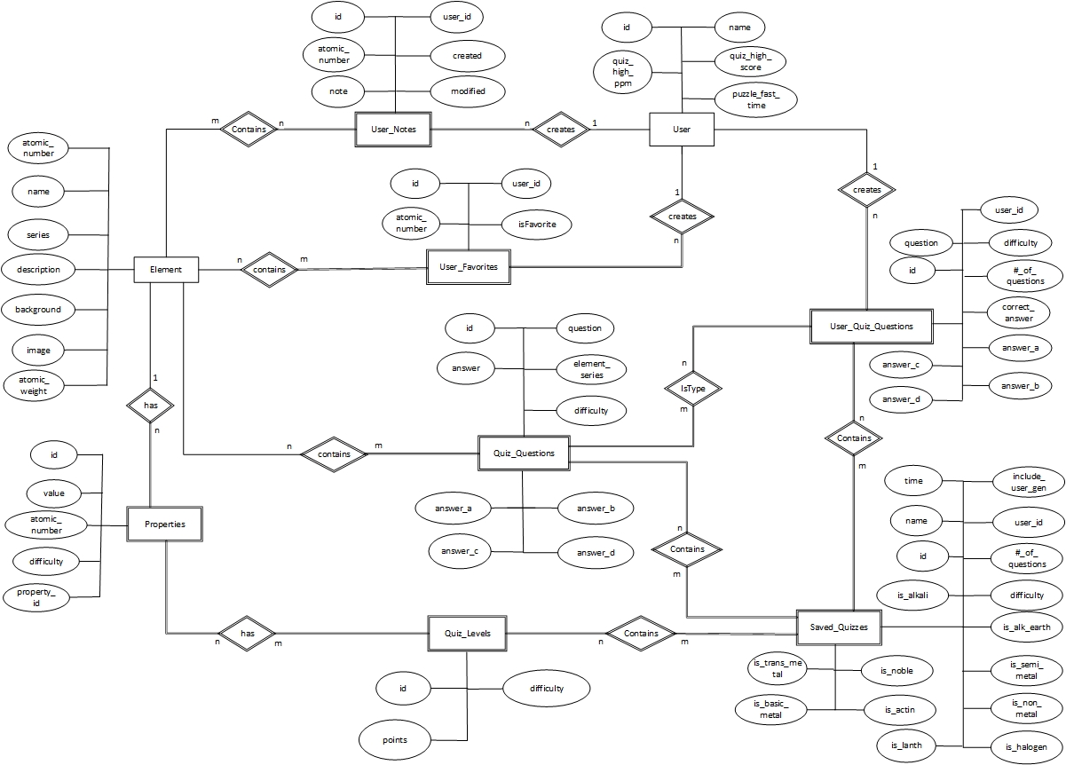
Database Design
Element
Properties
User
Quiz Questions

Slide 13
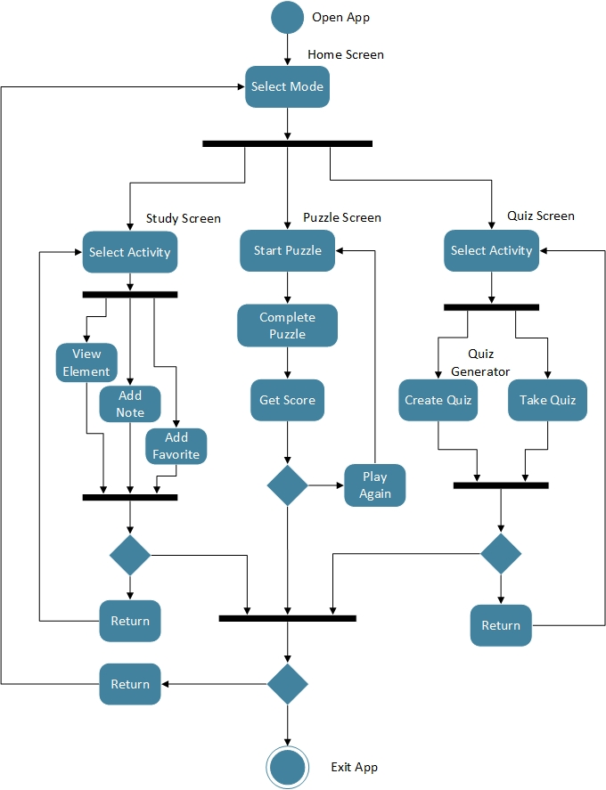
Implementation
Main Pages
Home Page
Study Page
Puzzle Page
Quiz Page

Slide 14
Validation and Verification

Slide 15
Objective
Testing Done as Three Separate Applications
The Testing Will Consist of 5 Types:
Acceptance/Functional
System
GUI Testing
Regression Testing
Integration

Slide 16
Testing Areas
In My Element App Launch
In My Element Start Screen/ Activity Selection Screen UI
Study Mode Interactive Periodic Table Activity
Quiz Mode Activity
Puzzle Mode Activity
Database Access and Manipulation

Slide 17
Program Test Areas, Brief Look
Activity Selection Screen UI
Types of Testing to Be Performed:
System
UI
Functional
Application Components to Be Tested:
Element of the Day Update
Element of the Day Study Page Display
Study Mode Activity Button
Quiz Mode Activity Button
Puzzle Mode Activity Button
App Bar Functions
Back Button

Slide 18
Example Test Cases
Test Type | Case # | Name | Description | Expected Result | Phase | Pass/Fail
Functional Testing | 9 | Element Selection | Verify each element is selectable | Every element can be selected | 2 | Pass
Graphical User Interface | 10 | Element Data Display | Once element is selected, verify if correct information is shown | Corresponding information to element is displayed | 2 | Pass
Functional Testing | 11 | Favorite Element | Check ability to add favorites tag to each element | Able to favorite each element and is displayed on Start Menu | 2 | Pass
Functional Testing | 12 | Element Notes | Check ability to add notes to each elements | The correct notes of the elements | 2 | Pass
Functional Testing | 13 | App Bar Functions | Test App Bar Functionalities | App Bar Functionalities working properly | 2 | Pass
Graphical User Interface | N/A | Puzzle Mode Initiation | Verify ability to enter Puzzle Mode | User enters puzzle mode | 2 | Functionality Removed
Graphical User Interface | N/A | Quiz Mode Initiation | Verify ability to enter Quiz Mode | User enters quiz mode | 2 | Functionality Removed

Slide 19
Product Evolution

Slide 20
Additional Platforms
Porting application to additional mobile operating systems
Porting to Android requires code to be translated to Java
Porting to iOS requires code to be translated to Objective C
Optimizations for smaller and larger screen sizes
Application is currently optimized for standard tablet and smaller laptop screen sizes

Slide 21
Additional Modes
Additional Quiz modes
More questions, more categories
Ability for the user to add questions
Compound Mode
User could combine two or more elements to create compounds
Research Mode
User could explore potential applications of uncommon elements and compounds

Slide 22
Features
Quiz score history
Sounds triggered by user actions
More animations to improve interactivity
Connection to Microsoft accounts to provide leaderboards for all app users
Windows Store App Certification

Slide 23
Data Changes
Element data will change
New elements are still being discovered
Some properties of known elements are uncertain and may change
Included quiz question base could be expanded
New questions and a greater variety of questions can be added so that users get new quiz experiences
For any database changes, local user data must be preserved

Slide 24
DEMO

Slide 25
Questions?

